Slide 1

SECOM Dataset Analysis - MohAMMAD GHUFRAN

Slide 2
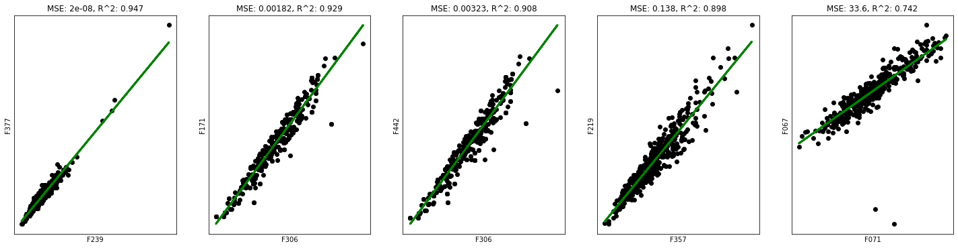
Virtual Metering
Sensors F071, F239, F306, and F357 have been identified as expensive
After analysis, it is found that all of these sensors can be replaced by other sensors
All of them are highly correlated with other sensors, meaning little information is lost by removing them
Examples of high correlations with other sensors are shown below:
Each plot shows a linear relationship between these sensors on the X axis and a highly correlated one on the Y axis.
Outliers are observed w.r.t. F067, which should be investigated, which lowers the fit

Slide 3
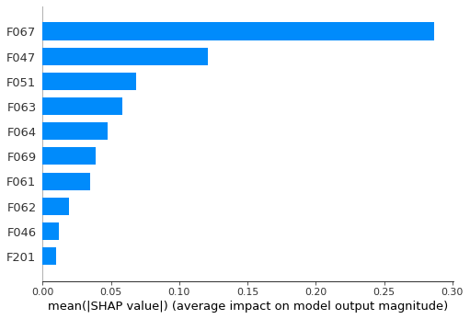
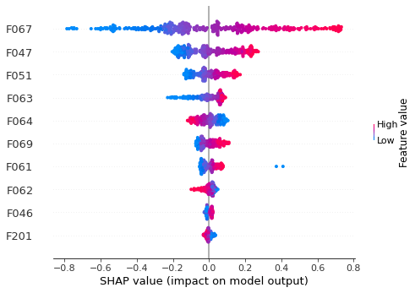
Virtual Metering
Further analysis is done with another approach.
A model is trained to predict a sensor’s value by using other sensors
An example for F071 is shown here:
This sensor is highly correlated with sensors F067, F047 and F051
First 4 sensors are positively correlated while the 5th one is negatively correlated

Slide 4
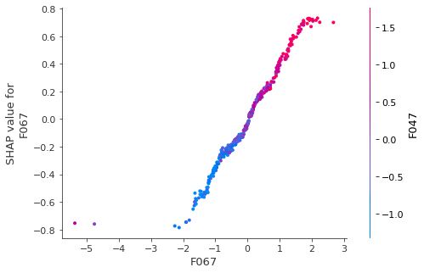
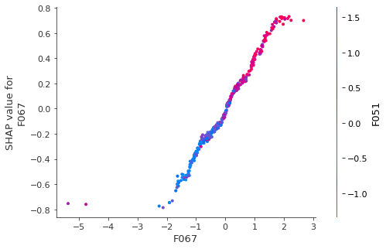
Virtual Metering
Further analysis is done with another approach.
We can also see, in more detail, interactions between these sensors
Each figure shows sensor F067 on the X-axis, and the color is represented by sensors F47 and F51
Both show direct correlations. Overall, feature F071 is well explained :
 | MSE | RMSE | MAE
Train | 0.141 | 0.375 | 0.215
Test | 0.080 | 0.283 | 0.212

Slide 5
Quality Control Assistance
In order to reduce manual control, several approaches can be thought of :
Ideal situation: train a model such that it replaces manual controls (implies comparable performance)
Verify all the products classified as faulty
A hybrid approach :
All faulty plus a percentage of normal products
Simply reduce manual controls, accepting costs incurred due to bad predictions
Current performance of the trained models is well below the performance of manual control
This implies replacing it will certainly incur additional costs

Slide 6
Quality Control Assistance
Proposed solution
A model should be trained, and predictions collected in parallel to manual controls
Identify the similarities / differences between the two results
This can help us choose under which conditions, manual controls can be replaced
With the known TPR and FPR, it is impossible to know the extent of quality of fit between manual and automatic predictions
A model which provides probabilities could be a good approach
In this case, cases on the decision boundaries can be controlled manually
Datasets with automatic predictions and corresponding manual results will be needed !

Slide 7
Concluding remarks
There are a lot of things that can be done, I have mentioned some ideas in the notebook provided
I’m not sure if I’ve correctly understood what was expected in question 2
If my understanding is correct, I think more information is needed
The dataset is quite hard to model, for instance, this paper shows better results than mine, but they are still far below the manual results cited
Globally, I’ve spent more than a day working on this in small chunks of time, mostly trying to find a good model

